Slide 1


CHEMICAL REACTIONS AND EQUATIONS
Class X · CBSE Science · Chapter 1
- Shubhranshu Sahu

Slide 2

Let's Rewind and Recall
Physical vs Chemical Change
Physical change: no new substance; often reversible (melting ice, dissolving sugar).
Chemical change: a new substance with new properties is formed (rusting, cooking, respiration).
Element, Compound, Mixture
Element = one kind of atom; compound = 2+ elements chemically combined in a fixed ratio.
Symbols & Formulae
H₂O, CO₂, CaCO₃, H₂SO₄ — subscripts = number of atoms; charges are superscripts (Na⁺, SO₄²⁻).
Valency & Formula Writing
Criss-cross rule: swap valencies to write a formula. Ca²⁺ + Cl⁻ → CaCl₂.
Common ions to know
Na⁺, K⁺, Ca²⁺, Al³⁺, Cl⁻, O²⁻, OH⁻, NO₃⁻, SO₄²⁻, CO₃²⁻.
Law of Conservation of Mass
Mass is neither created nor destroyed in a chemical reaction — the reason we balance equations.
Remember:
Total mass of reactants = total mass of products.

Slide 3
What is a Chemical Reaction?
Definition
A process in which one or more substances (reactants) change into one or more new substances (products) with different properties.
Example
Magnesium burns in air:
2Mg(s) + O₂(g) → 2MgO(s)
Important Result:
Clean the Mg ribbon with sandpaper first to remove the protective oxide layer so it burns readily.
How to Spot a Reaction
① Change in colour — white AgCl turns grey in light.
② Change in state — solid wax melts then burns.
③ Change in temperature — quick lime + water gets hot.
④ Evolution of a gas — Zn + acid gives H₂ bubbles.
⑤ Formation of a precipitate — an insoluble solid appears.

Slide 4
Chemical Equations & Their Symbols
Skeletal → Balanced
Reactants on the left, products on the right, joined by an arrow → pointing to the products.
Skeletal (unbalanced):
Zn + HCl → ZnCl₂ + H₂
Balanced:
Zn + 2HCl → ZnCl₂ + H₂↑
Important Result:
A balanced equation obeys the Law of Conservation of Mass.
Symbols You Must Use
(s), (l), (g) — solid, liquid, gas states.
(aq) — aqueous (dissolved in water).
↑ — gas released; ↓ — precipitate formed.
Δ (heat) — condition written above the arrow.
⇌ — reversible reaction.
Example:
3Fe(s) + 4H₂O(g) → Fe₃O₄(s) + 4H₂(g)

Slide 5
Balancing a Chemical Equation
Hit-and-Trial Method
1. Write the correct skeletal equation.
2. Start with the compound having the most atoms.
3. Balance atoms one element at a time using coefficients.
4. Balance hydrogen and oxygen last.
5. Check both sides are equal; add state symbols.
Important Result:
Never change a formula (its subscripts) to balance — only change the coefficients in front.
Worked Example
Fe + H₂O → Fe₃O₄ + H₂
Balance Fe: 3Fe + H₂O → Fe₃O₄ + H₂
Balance O: 3Fe + 4H₂O → Fe₃O₄ + H₂
Balance H: 3Fe + 4H₂O → Fe₃O₄ + 4H₂
Balanced:
3Fe(s) + 4H₂O(g) → Fe₃O₄(s) + 4H₂(g)
Check: Fe 3=3, H 8=8, O 4=4 ✓

Slide 6
Combination Reactions
Definition
Two or more reactants combine to form a single product.
A + B → AB
Slaking of lime (exothermic):
CaO(s) + H₂O(l) → Ca(OH)₂(aq) + heat
Important Result:
Quick lime CaO + water → slaked lime Ca(OH)₂, used to whitewash walls.
More Examples
Burning of coal:
C(s) + O₂(g) → CO₂(g)
Formation of water:
2H₂(g) + O₂(g) → 2H₂O(l)
Burning of magnesium:
2Mg(s) + O₂(g) → 2MgO(s)
Note:
Most combination reactions release heat, so they are exothermic.

Slide 7
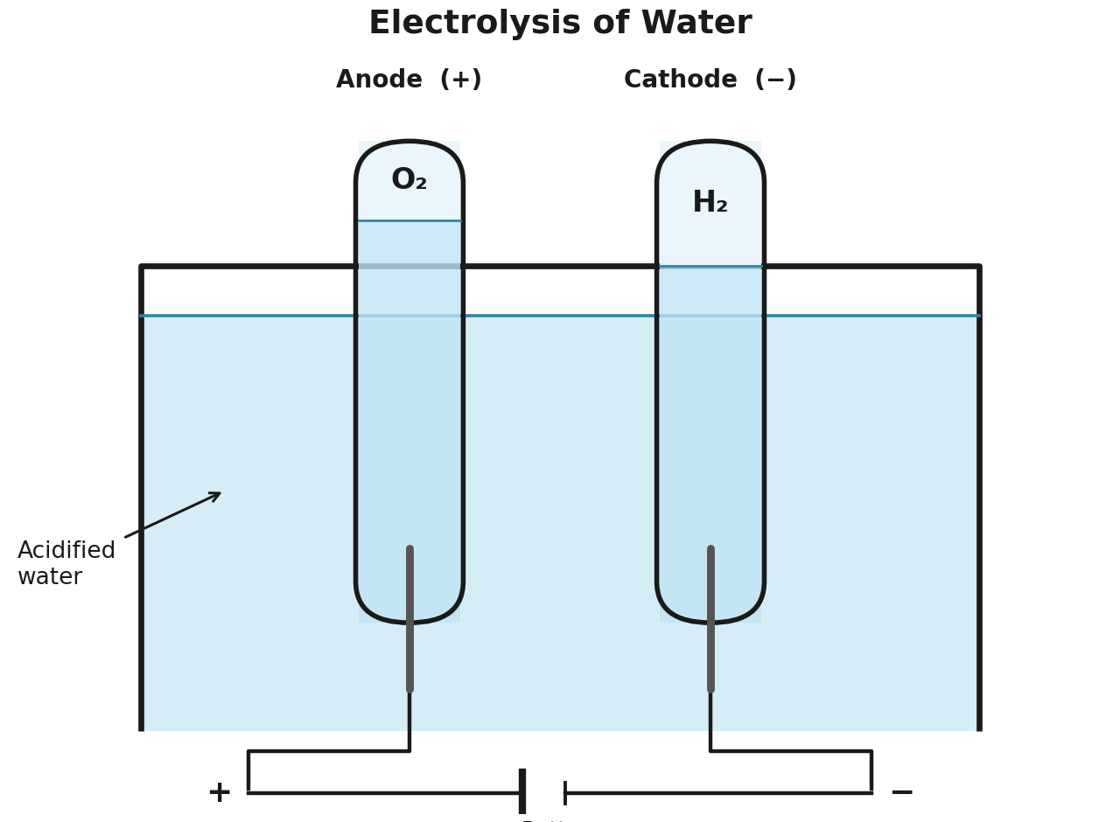
Decomposition Reactions
Definition
A single reactant breaks down into two or more products. AB → A + B
Thermal (heat, Δ):
CaCO₃(s) →Δ→ CaO(s) + CO₂(g)
2FeSO₄(s) →Δ→ Fe₂O₃(s)+SO₂(g)+SO₃(g)
Photolytic (light):
2AgCl(s) →light→ 2Ag(s) + Cl₂(g)
Electrolytic (electricity):
2H₂O(l) →elec.→ 2H₂(g) + O₂(g)
Important Result:
Decomposition is the opposite of combination and is usually endothermic.
H₂ (cathode) : O₂ (anode) = 2 : 1 by volume.

Slide 8
Displacement Reactions
Definition
A more reactive element displaces a less reactive element from its compound.
A + BC → AC + B
Iron nail in copper sulphate:
Fe(s)+CuSO₄(aq) → FeSO₄(aq)+Cu(s)
Colour: blue solution fades to pale green; brown Cu deposits on the nail.
Reactivity Decides
Zn(s)+CuSO₄(aq) → ZnSO₄(aq)+Cu(s)
Pb(s)+CuCl₂(aq) → PbCl₂(aq)+Cu(s)
Reactivity order (high → low):
K > Na > Ca > Mg > Al > Zn > Fe > Pb > (H) > Cu > Ag > Au
Important Result:
Cu cannot displace Zn or Fe; but Zn and Fe can displace Cu — always check the series.

Slide 9
Double Displacement & Precipitation
Definition
Two compounds exchange their ions to form two new compounds.
AB + CD → AD + CB
Precipitation reaction:
Na₂SO₄(aq) + BaCl₂(aq) →
BaSO₄(s)↓ + 2NaCl(aq)
White precipitate: insoluble BaSO₄.
Precipitate = insoluble solid
A precipitate is an insoluble solid formed when two solutions are mixed.
Another example:
AgNO₃(aq) + NaCl(aq) →
AgCl(s)↓ + NaNO₃(aq)
Important Result:
Every precipitation reaction is a double displacement reaction (ions are exchanged).

Slide 10
Oxidation, Reduction & Redox
Definitions
Oxidation: gain of oxygen OR loss of hydrogen.
Reduction: loss of oxygen OR gain of hydrogen.
Redox reaction:
CuO(s) + H₂(g) →Δ→ Cu(s) + H₂O(l)
CuO is reduced (loses O); H₂ is oxidised (gains O).
Important Result:
Oxidation and reduction always occur together — one substance is oxidised, the other reduced.
More Redox Examples
ZnO(s) + C(s) → Zn(s) + CO(g)
ZnO reduced; C oxidised.
MnO₂ + 4HCl →Δ→ MnCl₂ + 2H₂O + Cl₂
MnO₂ reduced; HCl oxidised.
Oxidising agent: supplies O / removes H (gets reduced).
Reducing agent: removes O / supplies H (gets oxidised).

Slide 11
Effects of Oxidation in Daily Life
Corrosion
The slow eating-up of a metal by air, moisture, acids etc.
Rusting of iron: reddish-brown Fe₂O₃·xH₂O (needs both O₂ and water).
Silver: black coat (Ag₂S). Copper: green coat.
Prevention:
Painting, oiling, greasing, galvanisation (zinc coat), chrome-plating, alloying.
Rancidity
Oxidation of fats and oils in food, giving a bad smell and taste.
How to prevent it:
• Add antioxidants.
• Flush the packet with nitrogen (as in chips packets).
• Store food in airtight containers.
• Refrigerate the food.
Important Result:
N₂ is used because it is unreactive and keeps out O₂.

Slide 12
Exothermic & Endothermic Reactions
Exothermic
Heat is released to the surroundings (products become warm).
Respiration:
C₆H₁₂O₆ + 6O₂ → 6CO₂ + 6H₂O + energy
• Burning of natural gas; CaO + water.
• Decomposition of vegetable matter into compost.
Remember:
Most combination reactions are exothermic.
Endothermic
Heat is absorbed from the surroundings (the mixture becomes cold).
Examples:
• Decomposition of calcium carbonate on heating.
• Dissolving ammonium chloride in water.
• Electrolysis of water.
Important Result:
Most decomposition reactions are endothermic (they need heat, light or electricity).

Slide 13
Important Results & Common Traps
Must-Know Results
• Balance by changing coefficients, never subscripts.
• Rusting needs BOTH air (O₂) and water.
• Galvanisation = coating iron with zinc.
• Photography uses AgBr / AgCl (photolysis).
• Precipitation is a type of double displacement.
• Oxidising agent gets reduced; reducing agent gets oxidised.
Common Traps
Trap 1 H₂O → H₂ + O₂ is wrong; it must be 2H₂O → 2H₂ + O₂.
Trap 2 Cu does NOT react with dilute HCl or H₂SO₄ (it is below H in the series).
Trap 3 Add acid to water, never water to acid — dilution is highly exothermic.
Trap 4 Green FeSO₄ on heating gives brown Fe₂O₃ and a smell of burning sulphur.

Slide 14
60-Second Recall & Quick-Fire
60-Second Recall
• Five signs of a reaction: colour, state, temperature, gas, precipitate.
• Types: combination, decomposition, displacement, double displacement, redox.
• Decomposition = thermal / photolytic / electrolytic.
• Corrosion (rusting) and rancidity are effects of oxidation.
• Exothermic releases heat; endothermic absorbs heat.
Quick-Fire Questions
1. Balance: Al + O₂ → Al₂O₃.
2. Name the gas at the cathode in electrolysis of water.
3. Why is AgCl stored in dark-coloured bottles?
4. Identify the type: BaCl₂ + Na₂SO₄ → BaSO₄ + NaCl.
5. In CuO + H₂ → Cu + H₂O, which is the reducing agent?
Try these before you flip to the worksheet!

Slide 15
THANK
YOU

